Slide 1
CS 31007 Autumn 2021 COMPUTER ORGANIZATION AND ARCHITECTURE
Instructors
Rajat Subhra Chakraborty (RSC)
Bhargab B. Bhattacharya (BBB)
Lecture #4:
Hardware-Software Interface: Instruction Set Architecture (ISA)
16 August 2021
Indian Institute of Technology Kharagpur
Computer Science and Engineering
Notes:
Good Morning!
The title of today’s talk is “On some Planar Partitioning Problems”.

Slide 2
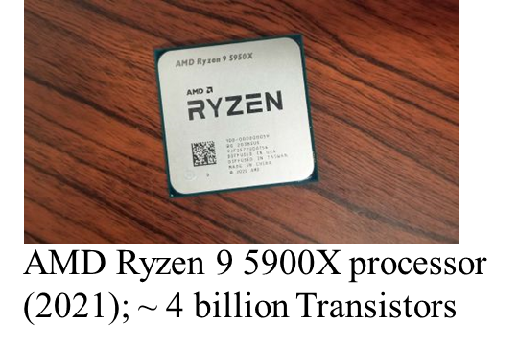
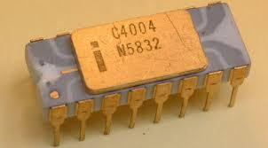
Building a Computer System ……
Technology scaling (Moore’s Law)
1970: 4004 μP
2300 transistors
Computing technology has scaled exponentially in performance for over half a century. This scaling was mostly the result of a virtuous cycle, where computers based on a new technology is used to create newer technology (Bootstrapping of CAD tools)

Slide 3
Computing System Hierarchy
Can understand high-level language, e.g.,
If X then C= A+B, else C= A-B
Application
software
Assembler
Compiler
Computer
Architecture
Instruction Set Architecture
Bare Machine
(Collection of circuits)
semantic gap
Hardware-Software Interface
Can understand symbolic assembly
language, e.g., add C, A, B
can understand only machine language – binary strings of 0’s and 1’s, (0101001100..) i.e., electrical off and on signals (Computer Organization)

Slide 4
Hardware-Software Interface
software
Instruction Set Architecture (ISA)
hardware
ISA: Collective attributes of the machine-language instruction set;
it defines the hardware-software interface
Courtesy: Patterson and Hennessy

Slide 5
Hardware Hierarchy
bare machine
CPU, RAM, Control, I/O
Flip-flops (memory), Registers,
Logic circuits
Logic gates – AND, OR, NAND
Transistors
(Semiconductor switches)
Wiring (interconnections), I/O pads, clocks, power

Slide 6
How a program is executed by a computer
Compiler
Assembler
binary machine code
00000000101000010000000000011000
00000000000110000001100000100001
10001100011000100000000000000000
10001100111100100000000000000100
10101100111100100000000000000000
10101100011000100000000000000100
00000011111000000000000000001000
Application software,
a program in C:
swap (int v[ ], int k)
{int temp;
temp = v[k];
v[k] = v[k+1];
v[k+1] = temp;
}
Compiler translates it to
assembly language program
of the target machine
swap;
muli $2, $5, 4
add $2, $4, $2
lw $15, 0 ($2)
lw $16, 4 ($2)
sw $16, 0 ($2)
sw $15, 4 ($2)
jr $31
Hardware
See pages 122-123
output

Slide 7
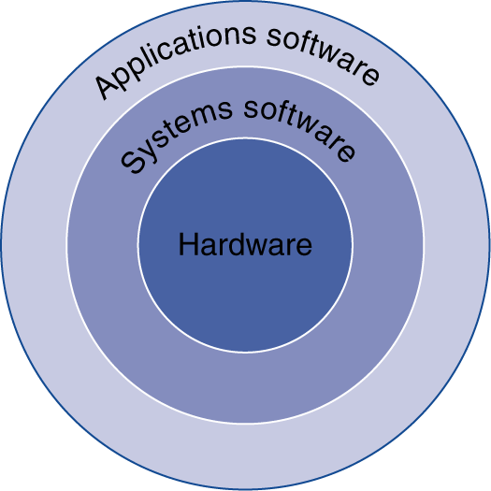
Below Your Program
Application software
Written in high-level language
System software
Compiler: translates HLL code to machine code
Operating System: service code
Handling input/output
Managing memory and storage
Scheduling tasks & sharing resources
Hardware
Processor, memory, I/O controllers
§1.3 Below Your Program

Slide 8
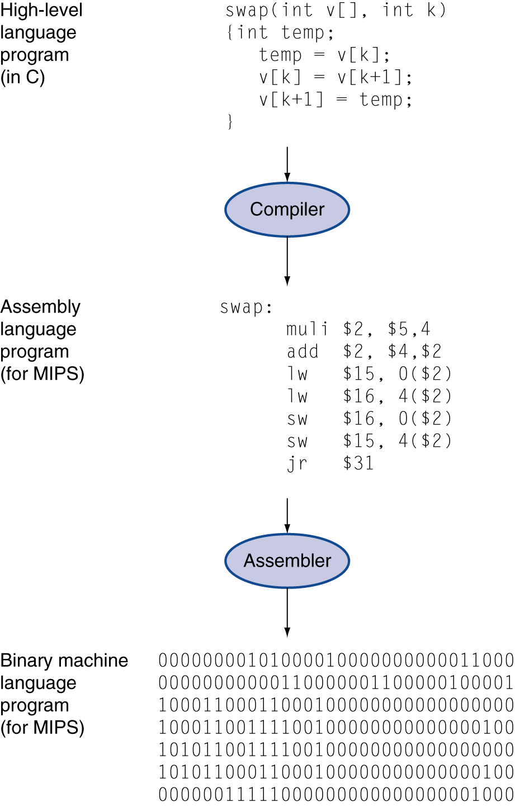
Levels of Program Code
High-level language
Level of abstraction closer to problem domain
Provides for productivity and portability
Assembly language
Textual representation of machine instructions
Hardware representation
Binary digits (bits)
Encoded instructions and data

Slide 9
Program Execution
Program written in high-level language, e.g., C
Questions:
Where is the compiler running?
Who compiles the compiler?
How is the Assembler running?
Compilier
Assembly-language code
Assembler
Machine-language code (binary)
Hardware
Result

Slide 10
System Hierarchy
Applications
Application Software
Algorithms
Programming Language
System Software
Operating Systems, Compilers
Instruction Set Architecture (ISA)
Bare Machine
(Hardware)
Microarchitecture
Gates/Register-Transfer Level (RTL)
Circuits – Gates, Flip-flops
Devices - Transistors
Physics

Slide 11
Computer Organization versus Computer Architecture
Computer Architecture (top-down view)
The view of a computer as perceived by software designers
Instruction Set Architecture (ISA)
Computer Organization (bottom-up view)
The actual implementation of components in hardware

Slide 12
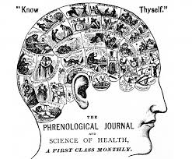
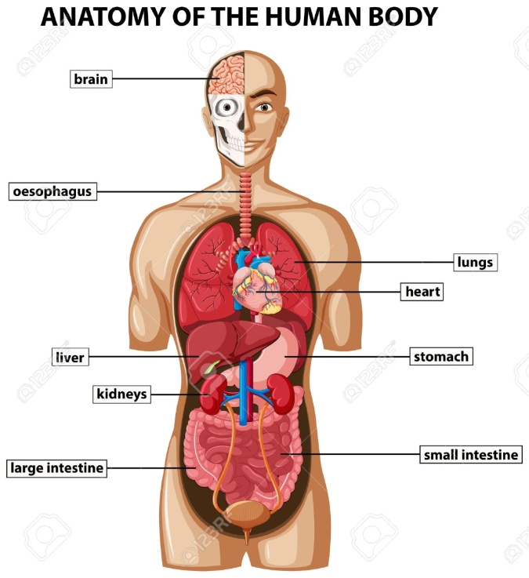
Computer Organization versus Computer Architecture
Computer Architecture: The personality of a machine
(behavioral view)
Instruction Set Architecture (ISA)
Computer Organization:
The anatomy of a machine
(structural view)

Slide 13
Computer Architecture
Architecture is visible to a programmer
Instruction set
Registers
Data representation, addressing modes
I/O mechanisms
Virtual view of memory

Slide 14
Computer Organization
Organization is visible to hardware designer
Hardware implementation of an instruction
Registers, program counter
Arithmetic and logical units
Control logic, internal states
Pipelining hardware
Cache and main memory

Slide 15
Computer Design Approach
System software
(OS, Compiliers)
System software
(OS, Compiliers)
Instruction Set Architecture (ISA)
Instruction Set Architecture (ISA)
Computer Organization
Computer Organization
Bottom-up approach:
Hardware first, ISA later
Top-down approach:
ISA first, hardware later

Slide 16
Instruction Set Architecture (ISA)
A set of assembly language instructions that separates the interface between software and hardware
In top-down design, given an ISA, an appropriate hardware platform is built to support it
Based on ISA, OS and compilers are to be developed accordingly further going up
Once ISA is fixed, software and hardware engineers can work independently (start from the middle!)
ISA is designed to optimize the performance supported by the available hardware technology.

Slide 17
The Hardware of a Computer
Registers
ALU
Control
Memory
I/O devices
Central Processing Unit (CPU)
Five easy pieces:
Control, Arithmetic Logic Unit (ALU), Memory, Input/Output, Datapath (Bus)

Slide 18
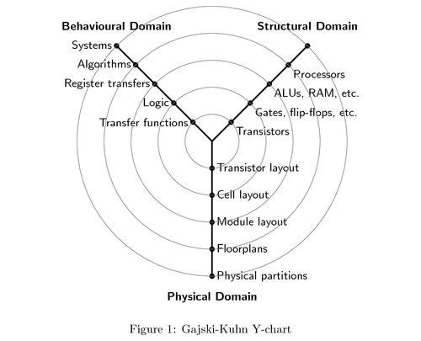
Digital System Design from Three Perspectives
Computer
Architecture
: Computer
Organization
: VLSI Design
Gajski-Kuhn Y-Chart (1983)

Slide 19
Factors behind the exponential growth of computing paradigms
Evolution of computer architecture
Growth of semiconductor technology and IC design processes
Memory technologies
Algorithms and data structures
Programming languages, compilers, OS
Test, verification, error management techniques
Bootstrapping: using present computers to design the next generation of computers (design automation)
Parallel and distributed computing
Networking, Cloud, IoT

Slide 20
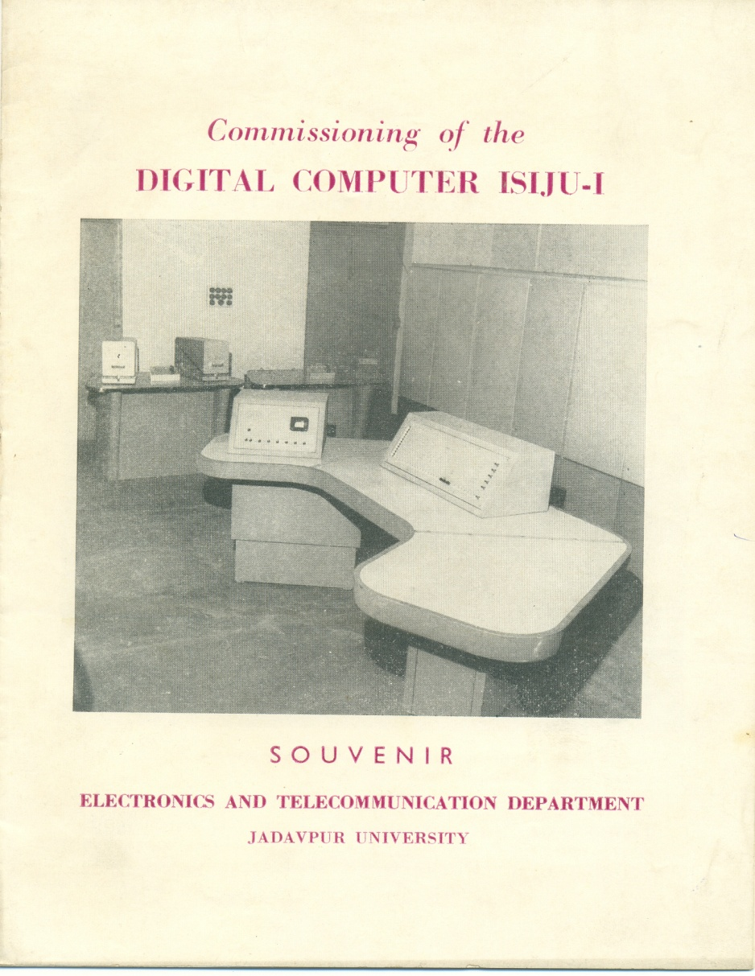
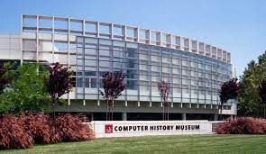
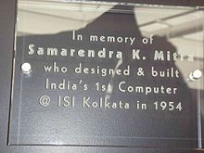
First Computer Built in India
In 1966, a fully-transistorized, digital computer named ISIJU was designed and commissioned, with joint collaboration between Indian Statistical Institute (ISI) and Jadavpur University (JU), Kolkata
Mountain View, CA
Commemoration plaque at the Computer History Museum, Mountain View, California, USA
In 1953, S K. Mitra designed and constructed the first (analog) computer built in India for solving linear equations with ten variables and related problems

Slide 21
CS 31007 Autumn 2021 COMPUTER ORGANIZATION AND ARCHITECTURE
Instructors
Rajat Subhra Chakraborty (RSC)
Bhargab B. Bhattacharya (BBB)
Lecture #5, #6:
17 August 2021
Indian Institute of Technology Kharagpur
Computer Science and Engineering
Notes:
Good Morning!
The title of today’s talk is “On some Planar Partitioning Problems”.

Slide 22
Next Agenda
Model for computation and Turing Machine
von Neumann Architecture
Basic Features of Instruction Set Architecture (ISA)
CPU Performance Equation
Amdahl’s Law; Gustavson-Barsis Law
RISC versus CISC
Die yield
Notes:
Good Morning!
The title of today’s talk is “On some Planar Partitioning Problems”.

Slide 23
Three Challenges
1. How to design compact, efficient, and reliable hardware (logic)?
2. What is the simplest, yet all powerful computer (computability)?
3. How should the basic computer architecture be conceived (mechanism for executing instructions)?

Slide 24
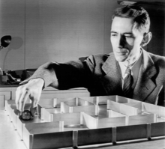
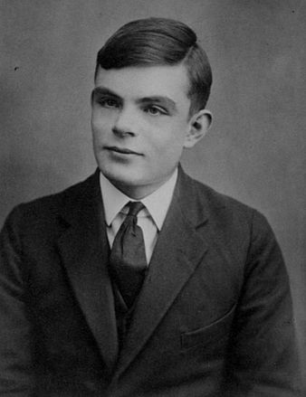
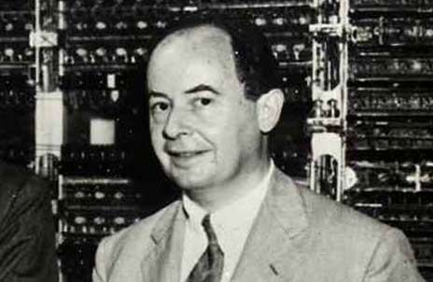
Pioneers who answered these three questions
John von Neumann (1903-1957)
Claude E. Shannon (1916-2001)
Alan Turing
(1912-1954)
Logic design
(basis of computer organization; hardware cost/ circuit delay/power optimization)
Theory of computability (basis for the fundamental requirement in computation)
Blueprint for basic computer architecture
Claude E. Shannon: A Symbolic Analysis of Relay and Switching Circuits, Master’s Thesis, MIT, 1937

Slide 25
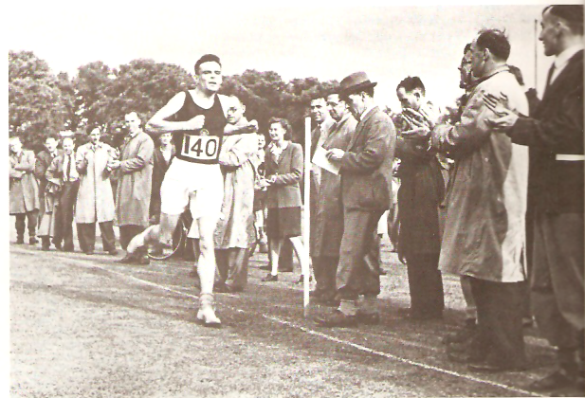
Turing Machine
Alan Turing, who gave the fundamental abstraction of a computing machine, was an excellent long distance runner
Pioneer of theoretical computer science and artificial intelligence
His father served in Indian Civil Service and worked in Odisha

Slide 26
What is the simplest yet all powerful computer?
Alan Turing (1936): Conceived a machine that introduces a model for computation (Turing Machine)
Infinite Tape
symbols (input, tape, blank)
$ 0 1 0 B 1 M 0 $
L
Finite-State Control
R
Read/Write Head
The tape head can move left or right
Actions: (present state, current symbol) →
(new state, write symbol, move one cell left/right);
-- The machine halts when an “accept”/”reject” state
is reached

Slide 27
Turing Machine
Very simple mechanism:
-- memory, control, read/write, shift, accept/reject
A. M. Turing (1936) , On Computable Numbers with an Application to the Entscheidungsproblem, Proc. Royal Math. Soc., Ser. 2, Vol. 42, pp. 230-265, 1936.
Extremely powerful
Church-Turing Conjecture (1936): A function on natural numbers can be calculated by an effective method if and only if it is computable by a Turing machine
Any procedure that is computable by paper-and-pencil methods (algorithm) can be solved by a Turing machine

Slide 28
Some Fundamental Limitations
Albert Einstein (1905):
Special theory of relativity → elimination of the notion of absolute time (postulate: the velocity of light is constant)
Kurt Gödel (1931):
Incompleteness theorem → questioned the notion of absolute mathematical truth
Alan Turing (1936):
Halting problem of Turing Machine → algorithmic inability to identify the presence of an infinite loop in arbitrary programs

Slide 29
Turing Undecidability?
Halting Problem: Can we write a program Q, which given any arbitrary program P as input, will decide whether on not P terminates or falls into an infinite loop on some input data?
Halting problem is Turing undecidable

Slide 30
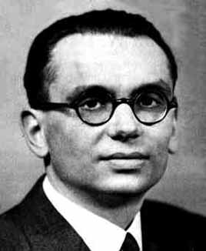
Gödel’s Incompleteness Theorem
In 1931, Gödel demonstrated that within any given branch of mathematics, there would always be some propositions that cannot be proven either true or false using the rules and axioms
Kurt Gödel
1906-1978

Slide 31
Father of AI/Machine Learning?
“What we want is a machine that can learn from experience”
- Alan Turing

Slide 32
von Neumann Architecture (1945): Princeton Architecture
Stored program concept
Serves as the basis for almost all modern computers
Instructions and data are just bits
Programs (sequence of machine instructions) are stored in memory to be read or written just like data
Registers
memory for data, programs,
compilers, systems programs
Processor
Memory
PC
Fetch & Execute Cycle (Instruction Cycle)
Program Counter (PC) points to the next Instruction to be fetched
Specific bits (opcode field) in the Instruction "control" subsequent actions
Fetch the “next” instruction and continue

Slide 33
Binary String Stored in Memory: Who am I?
X = - 1,880,113,152 (if X is a 2’s complement binary number)
X = 2,414,854,144 (when X is an unsigned binary number)
X = - 1.873 × 2⁻⁹⁶ (when X is a floating-point number)
X lw $t7, -16384 ($ra) (when X is a MIPS instruction)
Registers
Let the content (X) of a memory location be:
X: 0x 8FEFC000
X: 1000 1111 1110 1111 1100 0000 0000 0000
Processor
Memory
PC
Need execution cycles to interpret the binary strings properly – whether it is instruction or data, and if data, what type?

Slide 34
Execution Cycle a.k.a. Instruction Cycle
Obtain instruction from memory
Instruction
Fetch (IF)
Instruction
Decode (ID)
Determine required actions and instruction size
Operand
Fetch (Mem)
Locate and obtain operand data from memory/register (Mem)
Execute (EX)
Compute result value or status (Execute)
Result
Store (WB)
Deposit results in register/memory for later use (Write Back)
Determine successor instruction
(Program Counter points to next instruction; next sequential memory address or branch targets)
Next
Instruction

Slide 35
Features of von Neumann Architecture
Same physical memory to save instructions and data
Instruction fetch and data transfer cannot be done concurrently; they need separate clock cycles
Simple architecture
Harvard Architecture: Separate instruction and data memory

Slide 36
Harvard Architecture
CPU
ALU
Based on Harvard Mark I relay-based computer model
Separate signal pathways for instruction and data; can be accessed concurrently
Instruction
memory
Control
Data
memory
I/O devices

Slide 37
Full Picture
Processor
Devices
Control
Memory
for storing
instructions and data
Keyboard
Input
ALU
Mouse
Output
Datapath
Monitor
Printer
Notes:
1. The input devices bring the object code and input data from the outside world into the computer.

Slide 38
Next ..
How programs are translated into the machine language
And how the hardware executes them
The hardware/software interface
What determines program performance
And how it can be improved
How hardware designers improve performance
How parallel processing helps

Slide 39
How machine-language programs are executed?
Load Input Binary
000000 00000 00101 0001000010000000
000000 00100 00010 0001000000100000
100011 00010 01111 0000000000000000
100011 00010 10000 0000000000000100
101011 00010 10000 0000000000000000
101011 00010 01111 0000000000000100
000000 11111 00000 0000000000001000
Processor
Devices
Control
Memory
Input
Datapath
Output
Notes:
1. The input devices bring the object code and input data from the outside world into the computer.

Slide 40
Code Stored in Memory
Processor
Memory
Devices
000000 00000 00101 0001000010000000
000000 00100 00010 0001000000100000
100011 00010 01111 0000000000000000
100011 00010 10000 0000000000000100
101011 00010 10000 0000000000000000
101011 00010 01111 0000000000000100
000000 11111 00000 0000000000001000
Control
Input
Datapath
Output
Notes:
2. These data are kept in the computer’s memory until ...
Note that memory holds both INSTRUCTIONS and DATA and you can’t tell the difference. They are both just 32 bit strings of zeros and ones.

Slide 41
Processor Fetches an Instruction
Processor fetches an instruction from memory
pointed by Program Counter PC
Processor
instruction
Memory
PC
Devices
000000 00000 00101 0001000010000000
000000 00100 00010 0001000000100000
100011 00010 01111 0000000000000000
100011 00010 10000 0000000000000100
101011 00010 10000 0000000000000000
101011 00010 01111 0000000000000100
000000 11111 00000 0000000000001000
Control
Input
Datapath
data
Output
Where does it fetch from?
Notes:
3. The processor request and process them.

Slide 42
Control Decodes the Instruction
Processor
Devices
Control
000000 00100 00010 0001000000100000
Memory
Input
Datapath
Output
Control decodes the instruction to determine what to execute
Notes:
3. The processor control decodes the instruction in order to figure out what to tell the datapath to do

Slide 43
Datapath Executes the Instruction
Processor
Devices
Control
000000 00100 00010 0001000000100000
Memory
Input
Datapath
contents Reg #4 ADD contents Reg #2
results put in Reg #2
Output
Datapath executes the instruction as directed by control
Notes:
4. The operation of the datapath is controlled by the processor’s controller.

Slide 44
What Happens Next?
Processor
Memory
Devices
000000 00000 00101 0001000010000000
000000 00100 00010 0001000000100000
100011 00010 01111 0000000000000000
100011 00010 10000 0000000000000100
101011 00010 10000 0000000000000000
101011 00010 01111 0000000000000100
000000 11111 00000 0000000000001000
Control
Input
Datapath
Output
Fetch
Exec
Decode
Notes:
For lecture
3. What happens next (next instruction is fetched/how to tell where that instruction is located in memory/…)

Slide 45
Output Data Stored in Memory
Processor
Memory
Devices
Control
Input
00000100010100000000000000000000
00000000010011110000000000000100
00000011111000000000000000001000
Datapath
Output
On program completion, results reside in memory
Notes:
5. The data to be output are kept in the computer’s memory until ...

Slide 46
Output Device Outputs Data
Processor
Devices
Control
Memory
Input
Datapath
Output
00000100010100000000000000000000
00000000010011110000000000000100
00000011111000000000000000001000
Notes:
1. The output device outputs the data in the memory to the output medium.

Slide 47
Von Neumann Bottleneck
Von Neumann architecture uses the same memory for instructions (program) and data.
Memory is inherently slower than logic. The time spent in memory accesses can limit the performance. This phenomenon is referred to as von Neumann bottleneck.
To avoid the bottleneck, later architectures allow frequently used operands to reside in on-chip registers, or use cache.

Slide 48
Complete View of Computer Architecture
Cache Memory
(SRAM)
Control
Main Memory (DRAM)
Datapath
ALU
Registers
On-chip cache
Secondary Memory (Flash, Hard disk, SSD, CD)
Processor (CPU)
Tertiary Memory (Tape, RAID, Data centres, Network)
Use of memory hierarchy
reduces the transaction time
across CPU-memory interface
Memory

Slide 49
Memory Hierarchy (MH)
speed, cost
CPU
storage
capacity
MH reduces average CPU-Memory transaction time;
need additional hardware, OS (memory management)

Slide 50
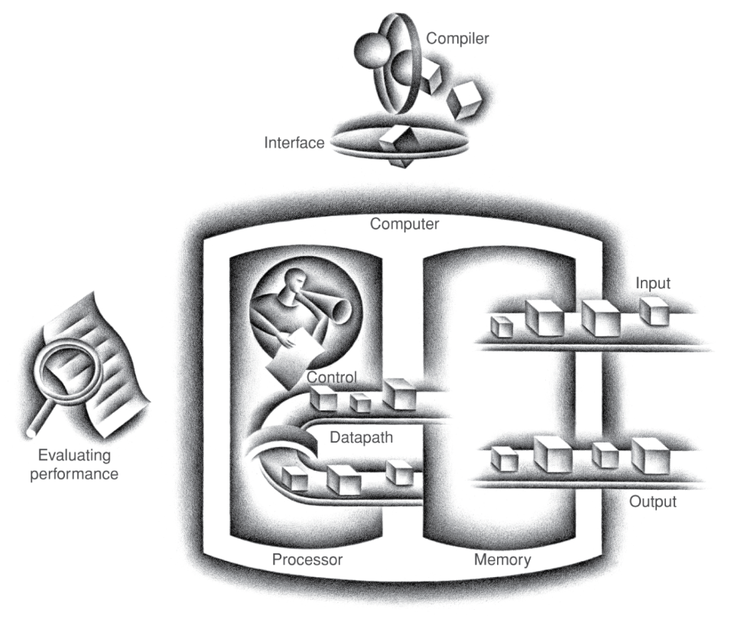
Components of a Computer
Same components for all kinds of computer
Desktop, server, embedded
Input/output includes
User-interface devices
Display, keyboard, mouse
Storage devices
Hard disk, CD/DVD, flash
Network adapters
For communicating with other computers
§1.4 Under the Covers
The BIG Picture

Slide 51
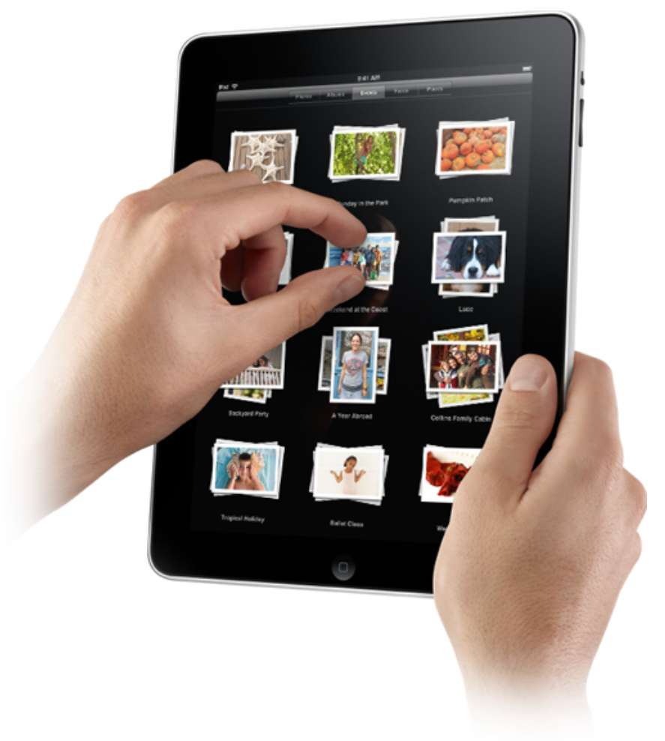
Touchscreen
PostPC device
Supersedes keyboard and mouse
Resistive and Capacitive types
Most tablets, smart phones use capacitive
Capacitive allows multiple touches simultaneously

Slide 52
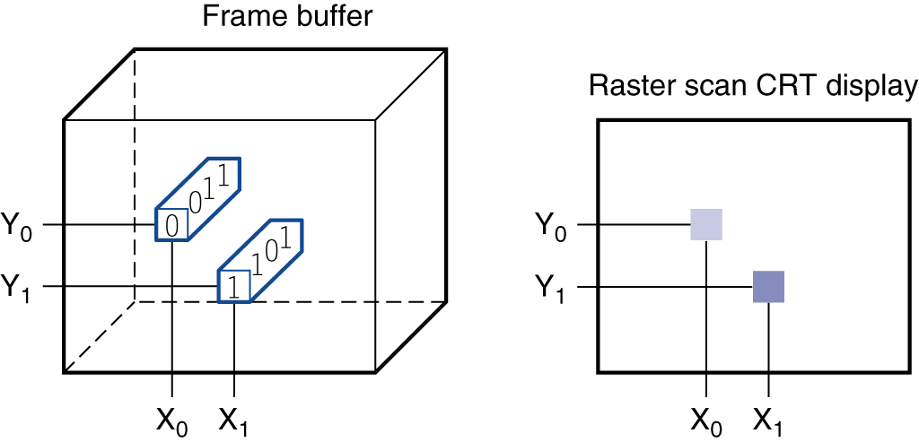
Through the Looking Glass
LCD screen: picture elements (pixels)
Mirrors content of frame buffer memory

Slide 53
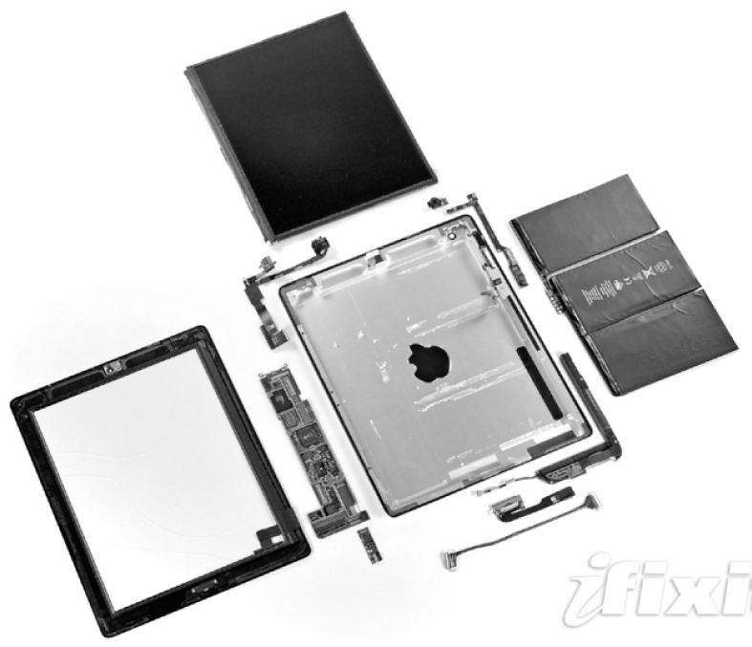
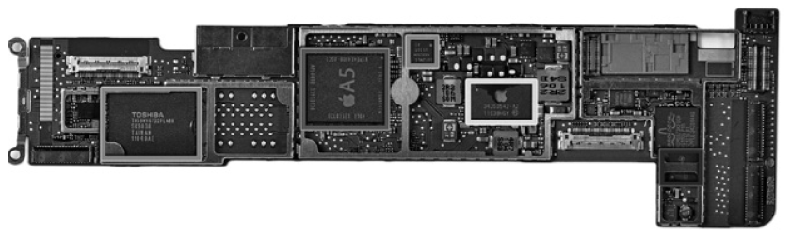
Opening the Box
Capacitive multitouch LCD screen
3.8 V, 25 Watt-hour battery
Computer board

Slide 54
Inside the Processor (CPU)
Datapath: performs operations on data
Control: sequences datapath, memory, ...
Cache memory
Small fast SRAM memory for immediate access to data

Slide 55
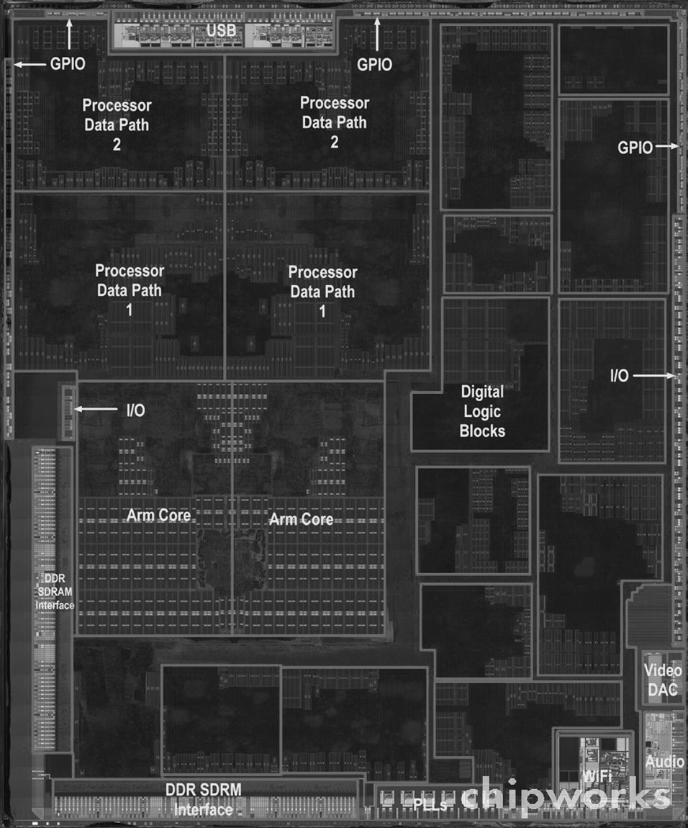
Inside the Processor
Apple A5

Slide 56
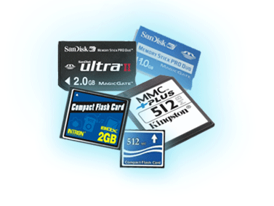
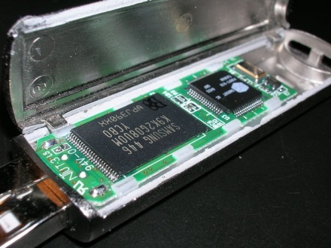
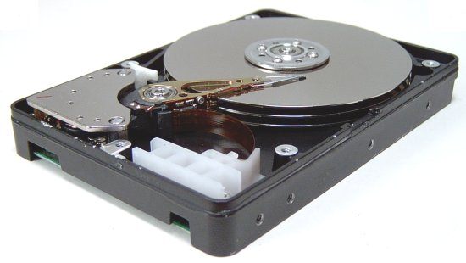
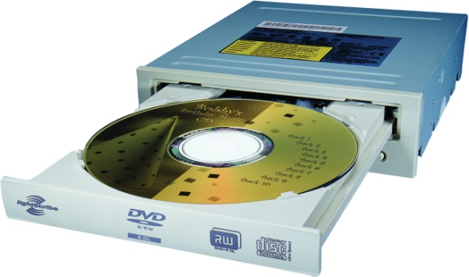
A Safe Place for Data
Volatile main memory
Loses instructions and data when power off
Non-volatile secondary memory
Magnetic disk
Flash memory, SSD
Optical disk (CDROM, DVD)

Slide 57
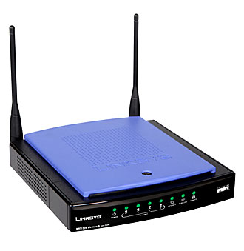
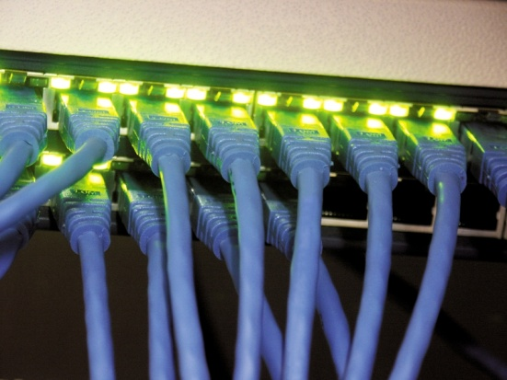
Networks
Communication, resource sharing, nonlocal access
Local area network (LAN): Ethernet
Wide area network (WAN): the Internet
Wireless network: WiFi, Bluetooth

Slide 58
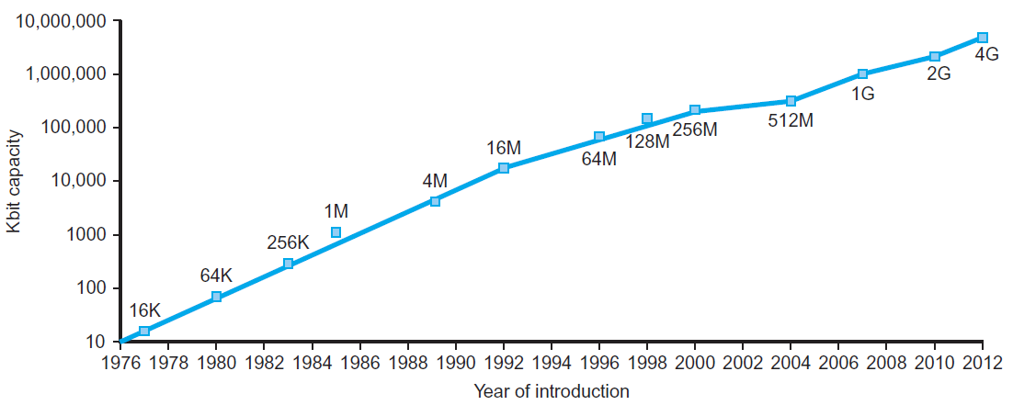
Technology Trends
Electronics technology continues to evolve
Increased capacity and performance
Reduced cost
§1.5 Technologies for Building Processors and Memory
DRAM capacity

Slide 59
Instruction Set Architecture (ISA)
The set of machine-level instructions in a particular CPU implementation is called Instruction Set
Goals of Instruction Set:
Software must be able to compute anything in a reasonable number of steps using the instructions in the instruction set
Different CPUs implement different sets of instructions

Slide 60
Features of Instruction Set Architecture (ISA)
Instruction format: length (how many bits – fixed or variable?), format, fields, opcodes, register specifications, how many operands/memory addresses specified?
Size of the logical address space? Addressability (byte/word level)?
Number of instructions? – determines #bits in op-code.
Instruction types? – arithmetic (integer/floating point), logical, data transfer, branch, procedure calls, bit-shifting
Addressing modes: immediate, direct, register, displacement, scaled, indirect; addressing granularity (word-level, byte-level?)
Others: Orthogonality, Completeness, Alignment (Big-Endian/Little-Endian)
ISA governs both hardware implementation (downward) and compiler design (upward)

Slide 61
Example: MIPS ISA
The length of every instruction = 32 bits
Memory is byte-addressable, word-organized, each word comprising 4 bytes = 32 bits
Width of the address bus: 32 bits; size of the logical address space = 2^32 bytes =2^30 words
32 on-chip general purpose registers, each 32-bit wide; register-ID needs 5 bits each
Integers, FP-numbers: 32 bits
Op-code in each instruction: 6 bits
-------------------------------------------------------------------------------------------------------------
MIPS: Microprocessor without Interlocked Pipeline Stages (RISC Computer, 1986)
MIPS: Million Instructions Per Second (Performance)

Slide 62
Example: MIPS Instruction
Collection of Assembly-level or Machine-level (M/L) instructions, which are executable by the hardware
An example of MIPS M/L instruction:
Total length of the instruction – 32 bits; opcode: 6 bits;
$t0, $s1 -> 32-bit CPU registers (ID: 5-bit each, as there are a total of 32 such registers); immediate value is provided as a 16-bit 2’s complement integer;
Add 5 to the content of $s1 and save the result in $t0
addi $t0, $s1, 5
op
s1
t0
Immediate
6 bits
5 bits
5 bits
16 bits
001000
10001
01000
0000000000000101

Slide 63
MIPS Load Instruction
16-bit 2’s complement number representing the immediate (offset) value
lw $t1 - 40($t2)
31
26
21
16
0
op
rs
rt
immediate
6 bits
5 bits
5 bits
16 bits
Registers
Meaning of lw $rt imm($rs):
R[rt] ← Mem{R[rs] + Sign_Ext(imm16)}
Processor
Memory
PC
MIPS is based on load-store architecture: instructions are broadly classified as two types - memory access (load and store between external memory and registers) and ALU operations (occurring only among internal registers)

Slide 64
Immediate Operands
Constant data specified in an instruction
addi $s3, $s3, 4
No subtract immediate instruction
Just use a negative constant
addi $s2, $s1, -1
Design Principle 3: Make the common case fast
Small constants are common
Immediate operand avoids a load instruction, which memory access

Slide 65
Arithmetic Operations
Add and subtract, three operands
Two sources and one destination
add a, b, c # a gets b + c
All arithmetic operations have this form
Design Principle 1: Simplicity favours regularity
Regularity makes implementation simpler
Simplicity enables higher performance at lower cost
§2.2 Operations of the Computer Hardware

Slide 66
Register Operands
Arithmetic instructions use register operands
MIPS has a 32 × 32-bit register file
Use for frequently accessed data
Numbered 0 to 31
32-bit data called a “word”
Assembler names
$t0, $t1, …, $t9 for temporary values
$s0, $s1, …, $s7 for saved variables
Design Principle 2: Smaller is faster
Compare to: main memory → millions of locations
§2.3 Operands of the Computer Hardware

Slide 67
Register Operand Example
C code:
f = (g + h) - (i + j);
f, …, j in $s0, …, $s4
Compiled MIPS code:
add $t0, $s1, $s2 add $t1, $s3, $s4 sub $s0, $t0, $t1

Slide 68
Memory Operands
Main memory used for composite data
Arrays, structures, dynamic data
To apply arithmetic operations
Load values from memory into registers
Store result from register to memory
Memory is byte addressed
Each address identifies an 8-bit byte
Words are aligned in memory
Address must be a multiple of 4; PC <- PC +4
MIPS is Big Endian
Most-significant byte at least address of a word
c.f. Little Endian: least-significant byte at least address

Slide 69
Registers vs. Memory
Registers are faster to access than memory
Operating on memory data requires loads and stores
More instructions to be executed
Compiler must use registers for variables as much as possible
Only spill to memory for less frequently used variables
Register optimization is important!

Slide 70
Performance Issues -- CPU-Performance Equation -- Amdahl’s Law

Slide 71
What Affects Performance?
Algorithm
Determines number of operations executed
Programming language, compiler, architecture
Determine number of machine instructions executed per operation →depends on ISA
Processor and memory system
Determine how fast instructions are executed
I/O system (including OS)
Determines how fast I/O operations are executed

Slide 72
Response Time and Throughput
Response time
How long it takes to do a task
Throughput
Total work done per unit time
e.g., tasks/transactions/… per hour
How are response time and throughput affected by
Replacing the processor with a faster version?
Adding more processors?
We’ll study their estimation

Slide 73
Response time: time between submission of a job (program P) and its completion (depends on overall system load)
This includes
--- I/O
--- Operating system time for managing programs, compile time, etc.
--- CPU-time includes time for executing the machine code for P, memory access time, procedure calls, and system time spent on P.
Performance is proportional to the inverse of the CPU time.

Slide 74
What determines the execution time of a machine/assembly-level program P when it is run on a machine M?
P consists of a number of machine-level instructions (IC: instruction count);
Each machine instruction requires several clock cycles to complete (CPI: average number of clock cycles per instruction);
Each clock cycle has certain time period (CCT: clock cycle time)
Thus, CPU-time = IC × CPI × CCT
(CPU Performance Equation)

Slide 75
ALU-op: 40%, Clock-cycles needed = 1
load-op: 20%, Clock-cycles needed = 2
store-op: 10%, Clock-cycles needed = 2
branch-op: 30%, Clock-cycles needed = 2
Hence CPI = 1*0.4 + 2*0.2 + 2*0.1 + 2*0.3
= 1.60

